Slide 1


简易查
详细设计

Slide 2
目录
01
02
总体设计
详细设计
伪代码
03
04

Slide 3

1 PART
总体设计

Slide 4
目录
01
02
总体设计
接口设计
03
运行设计
04
运行设计
系统数据结构设计
05
06
系统出错处理设计

Slide 5
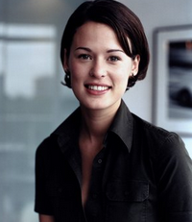



1PART
需求规定
系统功能
系统性能
软件输入输出要求
故障处理要求
股票信息获取与处理
产品信息查询
精度
时间特性要求
可靠性
灵活性
输入
输出
软件故障
硬件故障
故障处理

Slide 6
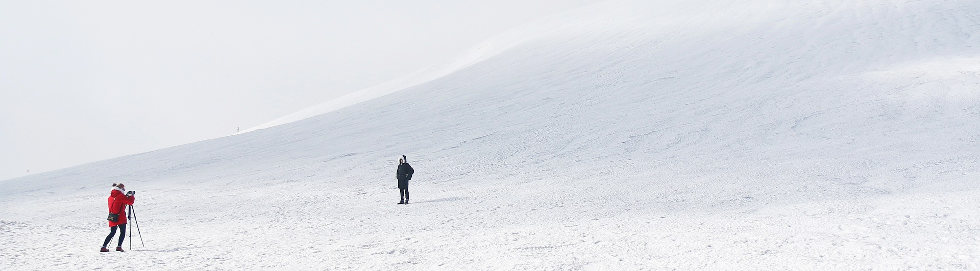
1PART
接口设计
用户接口
命令 | 语法 | 信息正确 | 信息错误
输入股票代码 | 点击事件 | 进入股票界面 | 停留主界面
自定义DIY策略 | 点击事件 | 进入自定义界面 | 停留股票界面
绑定qq | 点击事件 | 显示完成 | 停留当前页面

Slide 7

1PART
内部接口
模块名称 | 主界面模块 | 图片模块 | 信息模块
主界面模块 |  | √
图片模块 | √ |  | √
信息模块 |  | √

Slide 8



1PART
运行设计
运行模块组合
运行控制
运行时间
主界面显示大盘信息，界面下方可以进行单股信息查询。点击查询，输出股票信息，并在旁边提供DIY策略功能。用户DIY策略后，后台根据用户的策略不断进行运算，在达到用户设置要求后进行qq推送。
1)得到需要查询股票的代码（如民生银行 00016）
2)在后台调用API获取改股票信息
3)在界面显示出的该股票信息；
在需求分析中，对运行时间的要求为必须对作出的操作有较快的反应。网络硬件对运行时间有最大的影响，当网络负载量大时，操作反应时间将受到很大的影响。

Slide 9
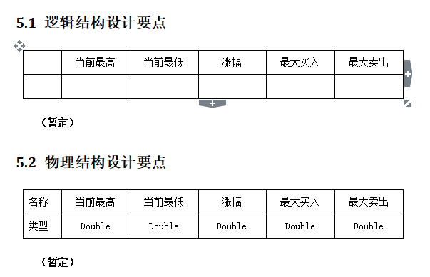

1PART
系统数据结构设计

Slide 10

2 PART
详细设计
As a web designer, I am always looking for awesome photos to include in my designs and mockups. I hate buying stock photos just to use them once.

Slide 11
目录
01
02
系统结构
建库模块设计说明
03
输入模块设计说明
04
匹配模块设计说明
输出模块设计说明
05
06
详细的实现计划

Slide 12

2PART
系统结构
系统结构框图
系统结构框图
HIPO图
HIPO图
IPO表

Slide 13




2PART
输入模块设计说明
The title content
模块描述
设计方法（算法）
流程逻辑

Slide 14





2PART
匹配模块设计说明
Under the blue below the template input title
模块描述
设计方法（算法）
流程逻辑
Free images and videos you can use anywhere. All images and videos on Pixabay
If you haven’t found the public domain images you were looking for at Public Domain Archive
Although, you’re more than welcome to let me know if you use images for a website

Slide 15

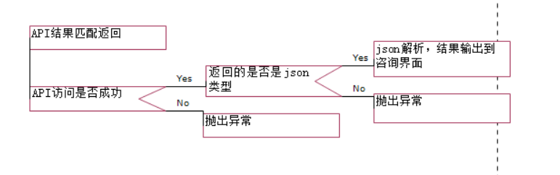
2PART
输出模块设计说明
流程逻辑

Slide 16

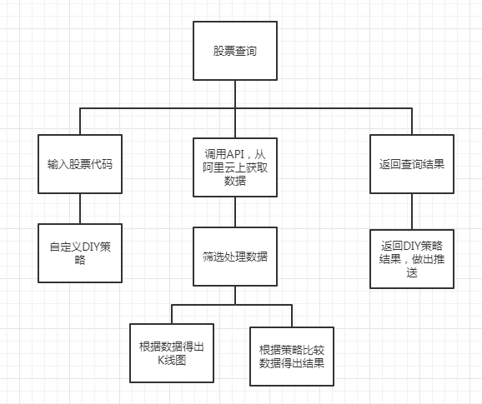
2PART

Slide 17
3 PART
The title content
As a web designer, I am always looking for awesome photos to include in my designs and mockups. I hate buying stock photos just to use them once.

Slide 18
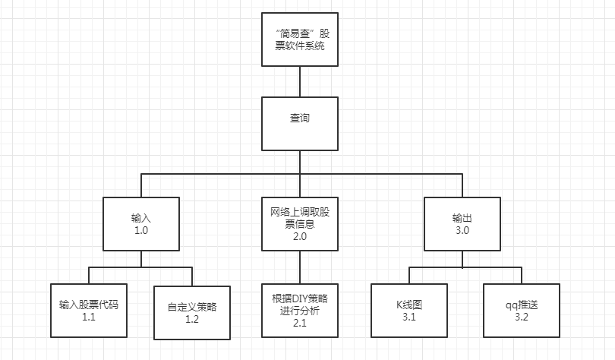
3PART

Slide 19



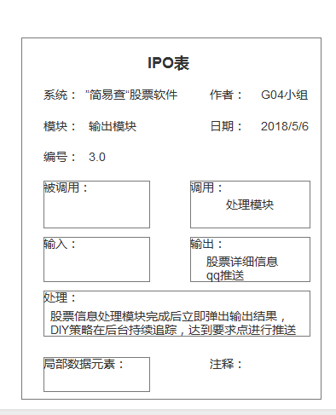
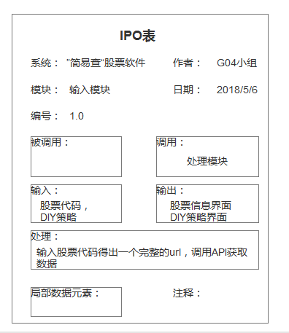
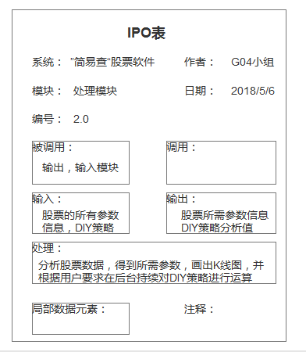

3PART
输入模块IPO表
处理模块IPO表：
输出模块IPO表
Under the blue below the template input title
Under the blue below the template input title
Under the blue below the template input title

Slide 20

THANKS
This PowerPoint applies to business summary, work report
Morning for PPT

Slide 21

3PART
The
title content
6
5
4
3
2
1
0
TEXT01
TEXT02
TEXT03
TEXT04

Slide 22
3PART
title content
The title content
Although, you’re more than welcome to let me know if you use images for a website
title content
title content
As a web designer, I am always looking for awesome photos to include in my designs and mockups. I hate buying stock photos just to use them once.
title content

Slide 23
3PART
The title content
As a web designer, I am always looking for awesome photos to include in my designs and mockups. I hate buying stock photos just to use them once.
YOUR TITLE
YOUR TITLE
YOUR TITLE
YOUR TITLE
If you haven’t found the public domain images you were looking for at public domain archive.
If you haven’t found the public domain images you were looking for at public domain archive.
If you haven’t found the public domain images you were looking for at public domain archive.
If you haven’t found the public domain images you were looking for at public domain archive.

Slide 24
4 PART
The title content
As a web designer, I am always looking for awesome photos to include in my designs and mockups. I hate buying stock photos just to use them once.

Slide 25
4PART
Title
content
I decided to make a list of some of my favorite sites for free stock photos. If you haven’t found the public domain images you were looking for at Public Domain Archive
Free images and videos

Slide 26

4PART
The title content
As a web designer, I am always looking for awesome photos to include in my designs and mockups. I hate buying stock photos just to use them once.
Under the blue below the template input title
Under the blue below the template input title
Under the blue below the template input title
86%
78%
52%
The title 01
The title 02
The title 03

Slide 27




4PART
Title content
Title content
Title content
If you haven’t found the public domain images you were looking for at public domain archive.
If you haven’t found the public domain images you were looking for at public domain archive.
If you haven’t found the public domain images you were looking for at public domain archive.

Slide 28

4PART
The title content
As a web designer, I am always looking for awesome photos to include in my designs and mockups. I hate buying stock photos just to use them once.

Slide 29

4PART
Input
the title content
Although, you’re more than welcome to let me know if you use images for a website
Free images and videos you can use anywhere. All images and videos on Pixabay
Under the blue below the template input title
you were looking for at public domain archive.

Slide 30
更多精品PPT资源尽在—优品PPT！
www.ypppt.com
PPT模板下载：www.ypppt.com/moban/ 节日PPT模板：www.ypppt.com/jieri/
PPT背景图片：www.ypppt.com/beijing/ PPT图表下载：www.ypppt.com/tubiao/
PPT素材下载： www.ypppt.com/sucai/ PPT教程下载：www.ypppt.com/jiaocheng/
字体下载：http://www.ypppt.com/ziti/ 绘本故事PPT：http://www.ypppt.com/gushi/
Notes:
模板来自于 http://www.ypppt.com

